Slide 1
CE 231 – FLUID MECHANICS Bernoulli Equation
Selva Balaji M
Department of Civil Engineering
Selva.Balaji@pilani.bits-Pilani.ac.in

Slide 2
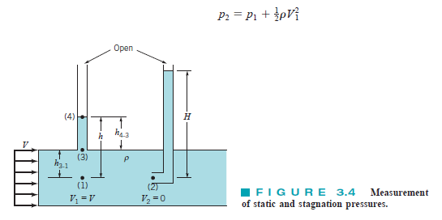
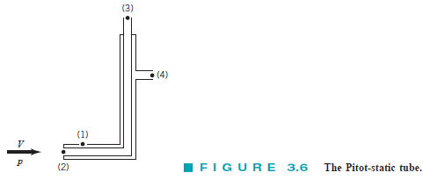

Euler Equation
$$−γ\sin{θ}−\frac{∂p}{∂s}=ρV\frac{∂V}{∂s}=ρa_{s}$$
Since normal component n is constant along the streamline s,
$−γ\frac{dz}{ds}−\frac{dp}{ds}=\frac{1}{2}ρ\frac{∂{(V}^{2})}{∂s}=ρa_{s}$

Slide 3


Pitot Tube and Pitot-Static Tube

Slide 4
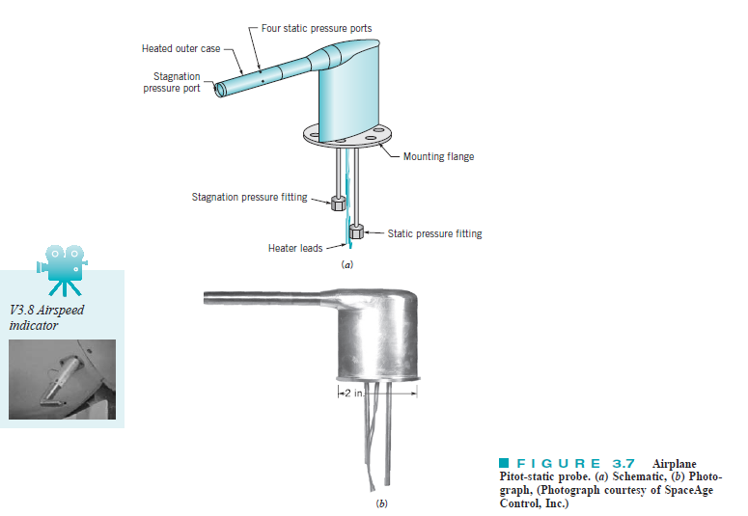
Pitot Tube and Pitot-Static Tube
Munson et al. (2009)

Slide 5
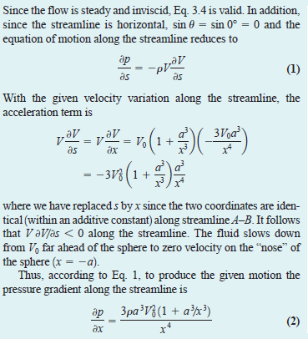
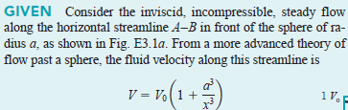

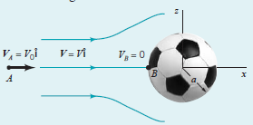
Pitot Tube and Pitot-Static Tube

Slide 6
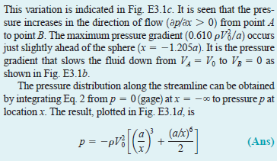
Pitot Tube and Pitot-Static Tube

Slide 7
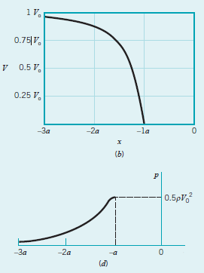
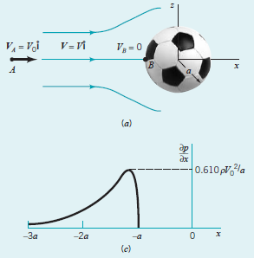

Slide 8
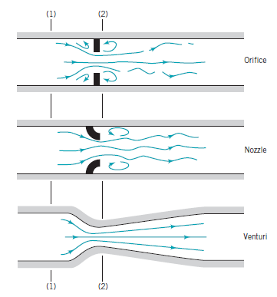
Flow Measurement

Slide 9
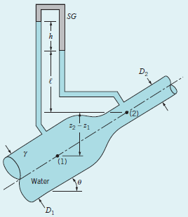
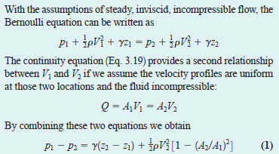
Flow in a Variable Area Pipe
Determine the manometer reading, h

Slide 10
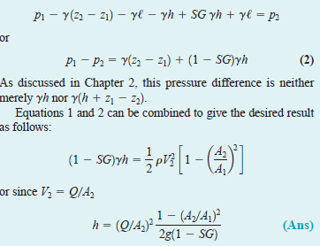
Flow in a Variable Area Pipe
Determine the manometer reading, h

Slide 11
Flow in a Variable Area Pipe
Determine the manometer reading, h

Slide 12
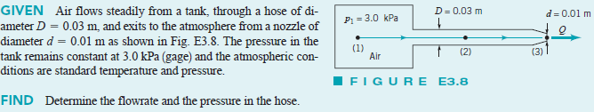
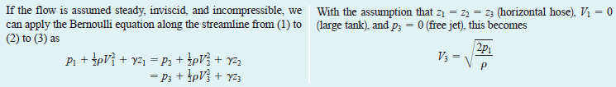
Flow in a Variable Area Pipe
Determine the manometer reading, h

Slide 13
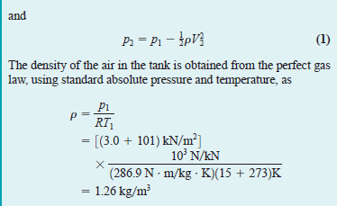
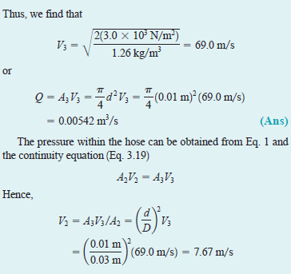

Flow in a Variable Area Pipe
Determine the manometer reading, h

Slide 14

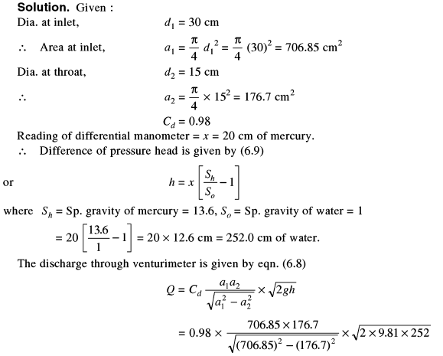
Ans: 125.76 liters/s

Slide 15
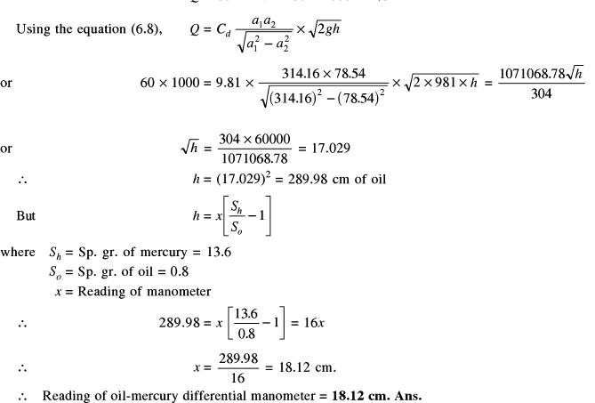

Slide 16
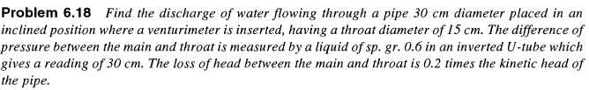
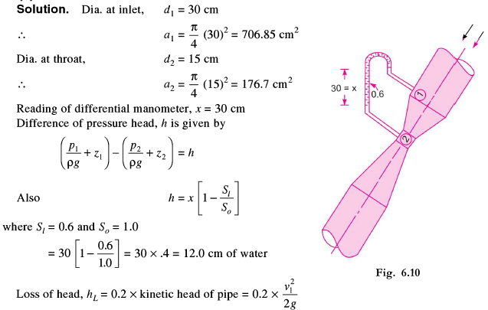

Slide 17
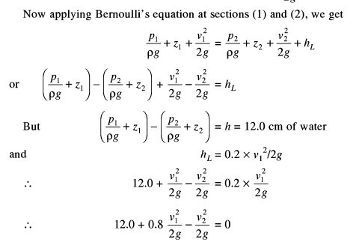
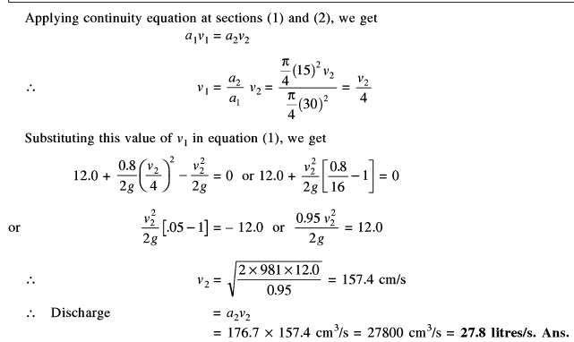

Slide 18
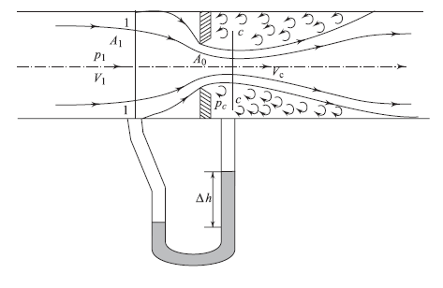
Orificemeter
A₀ – Orifice cross sectional area
A₁ – Pipe cross sectional area (Flow is uniform; Approximately
One diameter upstream of orifice plate)
A_{c} – Cross sectional area at Vena Contracta (Minimum
Pressure and maximum velocity point corresponding to
minimum area); Usually half diameter downstream of
Orifice plate
x

Slide 19
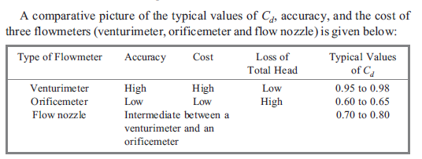
Comparison of flow measuring devices
x

Slide 20
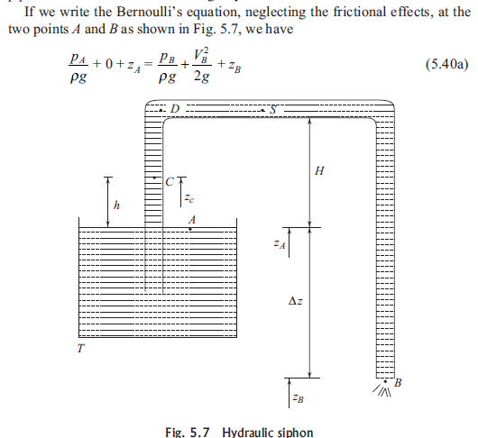
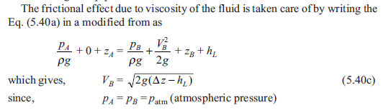
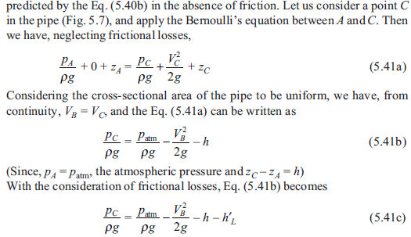
Siphon
x

Slide 21
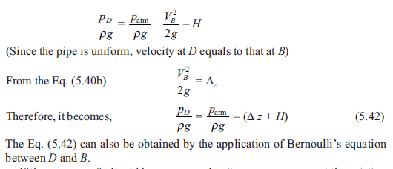
Siphon
x

Slide 22
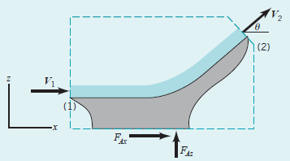
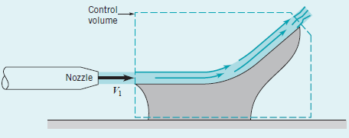
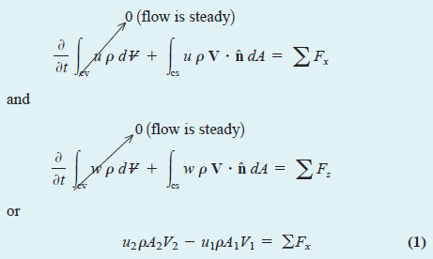
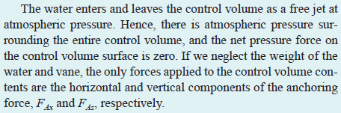
Linear Momentum – Change in Flow Direction
As shown in Fig., a horizontal jet of water exits a nozzle with a uniform speed of V₁ 4 m/s, strikes a vane, and is turned through an angle theta. Nozzle area is 0.006 m². Use theta 30 degrees

Slide 23
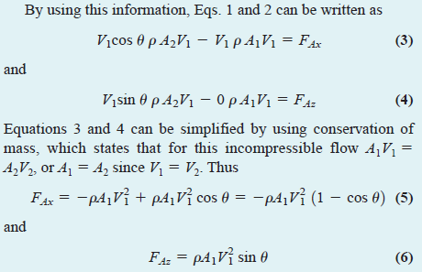
Linear Momentum – Change in Flow Direction
As shown in Fig., a horizontal jet of water exits a nozzle with a uniform speed of V₁ 4 m/s, strikes a vane, and is turned through an angle theta. Nozzle area is 0.006 m². Use
Atmospheric pressure around the jet and area is equal at inlet and outlet. Viscous
Forces and gravity forces assumed to be negligible.

Slide 24
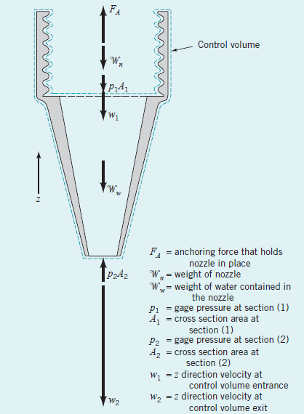
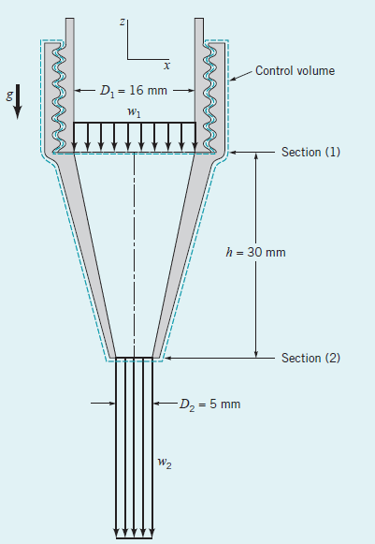
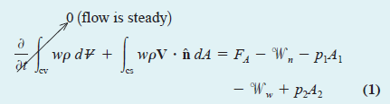
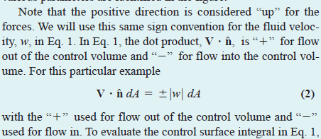
As shown in Fig, water flows through a nozzle attached to the end of a laboratory sink faucet with a flowrate of 0.6 liters/s. The nozzle inlet and exit diameters are 16 and 5 mm, respectively, and the nozzle axis is vertical. The mass of the nozzle is 0.1 kg. The pressure at section (1) is 464 kPa.

Slide 25
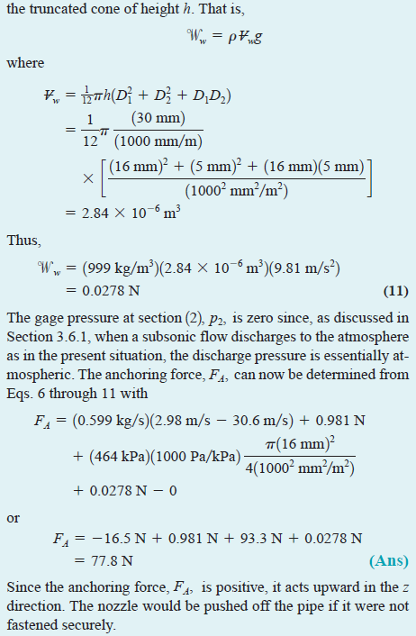
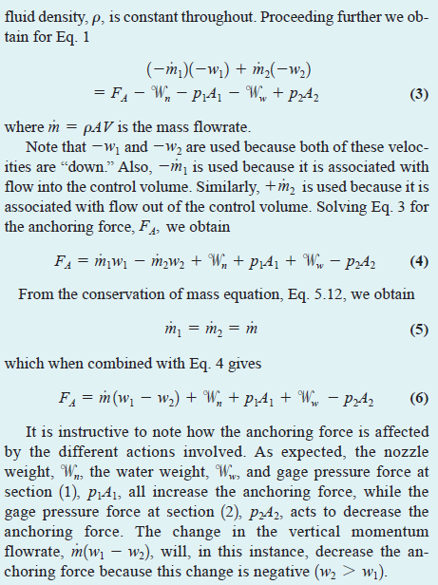
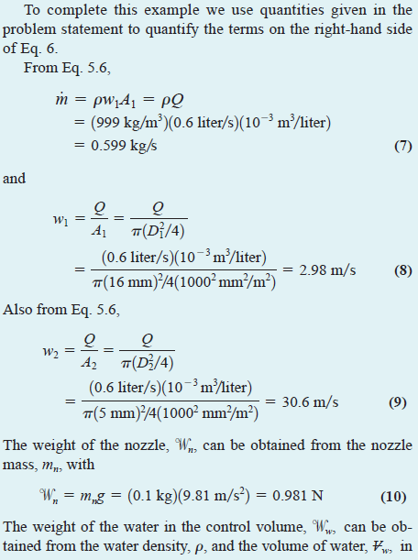

Slide 26
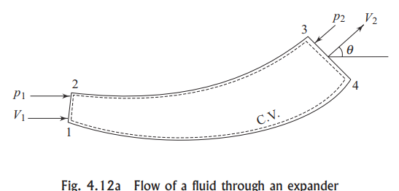
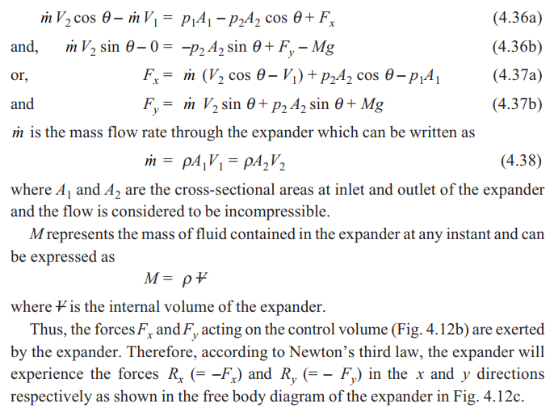
Inertial Control Volume

Slide 27
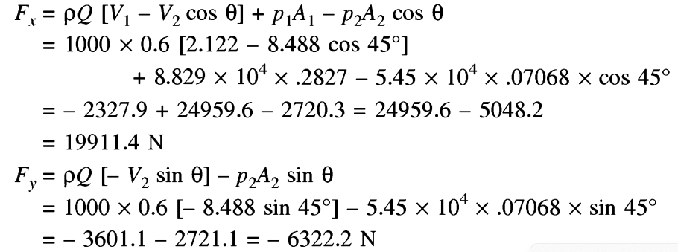
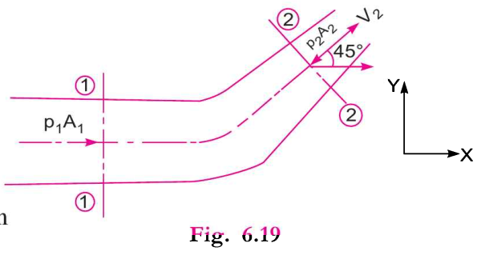
Inertial Control Volume
F_{y}

Slide 28
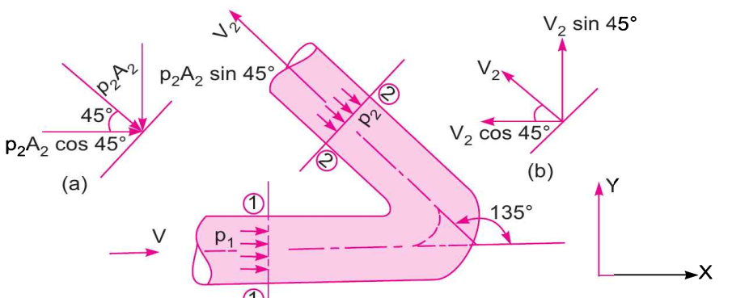
Inertial Control Volume

